Slide 1
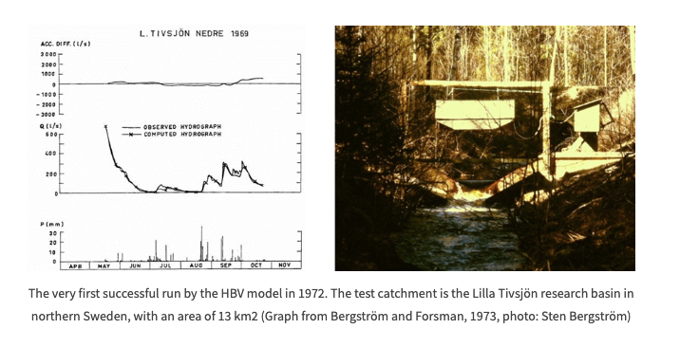
Intro to hydrological modeling: the HBV model

Slide 2
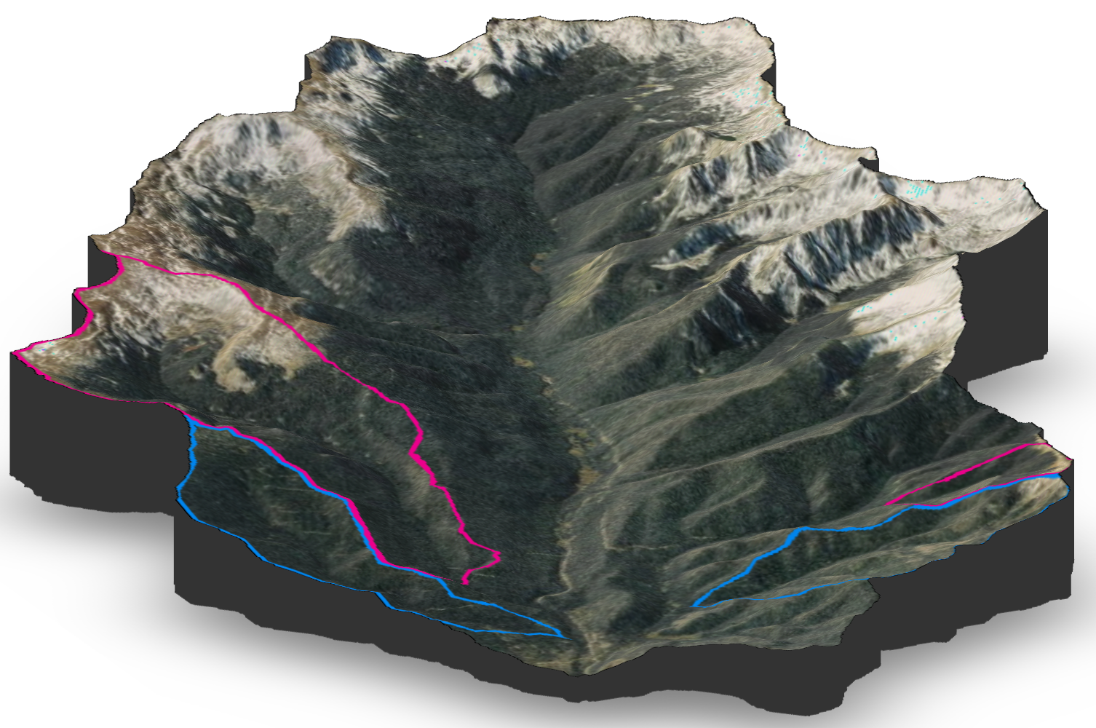
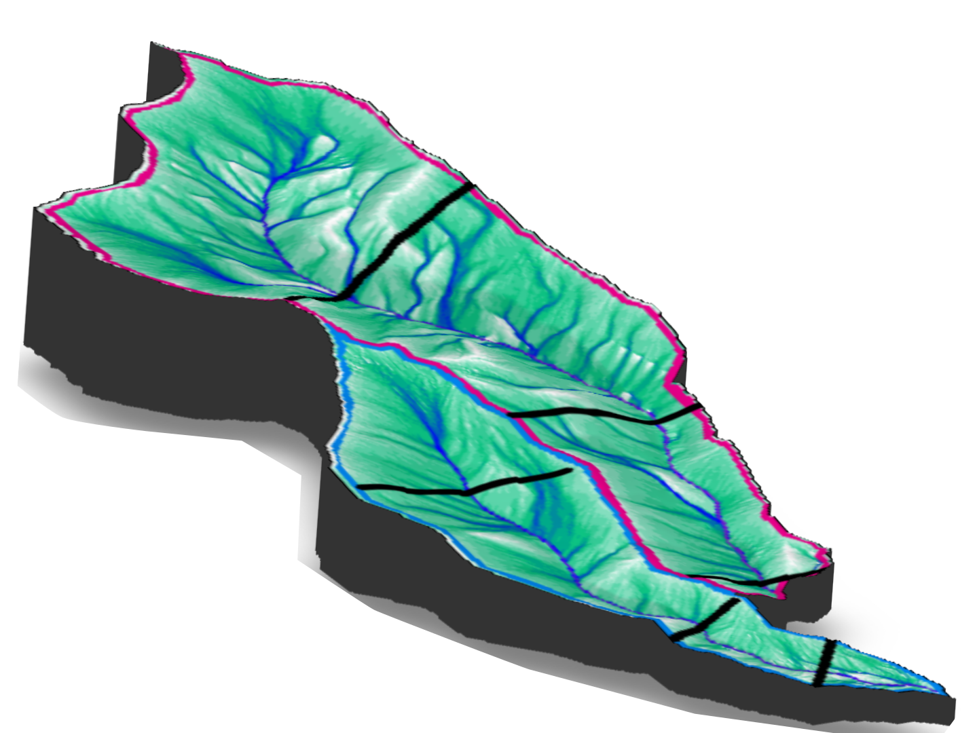
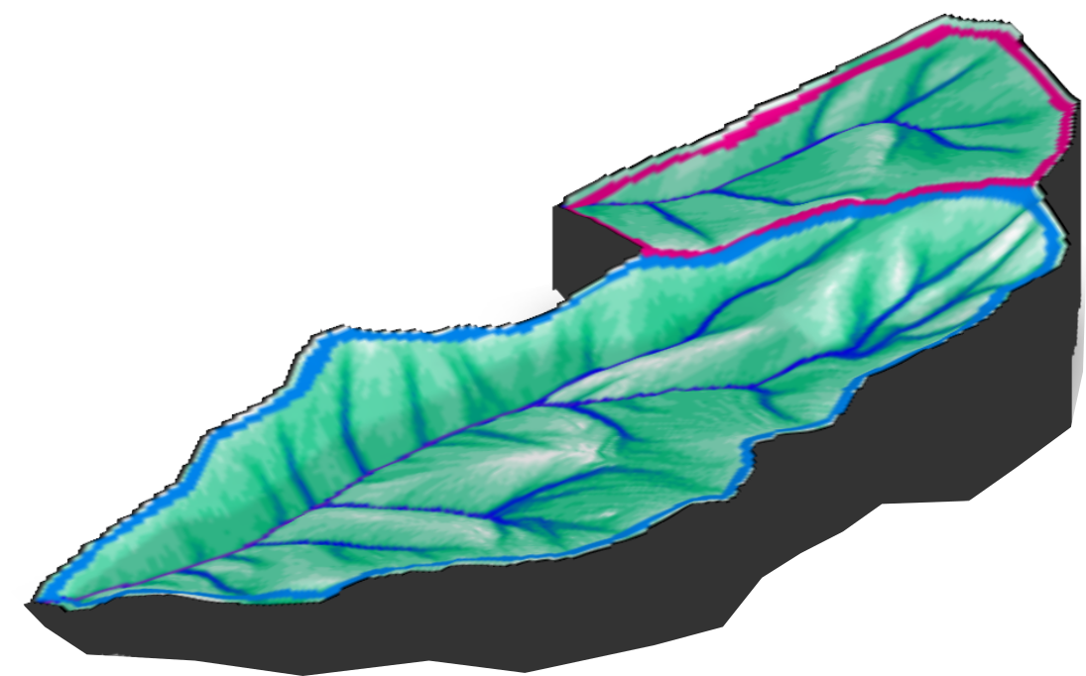
Old-growth
Old-growth
Regenerating
Stream metabolism station
Hillslope-riparian-stream transect

Slide 5
Types of models
Lumped
Treat basin as single homogenous element
Develop single outflow hydrograph
Semi-distributed
Discretize the watershed into homogenous sub-basins based on topography or drainage area
Distributed models within a GIS framework use parameter maps derived from geospatial data to simulate hydrologic process

Slide 6
Steps of a hydrological model
The Perceptual model: deciding on the processes
The Conceptual model: deciding on the equations
The Procedural model: developing the model code
Model calibration: getting values of parameters
Model validation: confirming applicability and accuracy”
To these phases Clark et al (2011) also add: 6. Characterizing the model uncertainty
which is a requirement that certainly contemporary modelling demands.

Slide 7
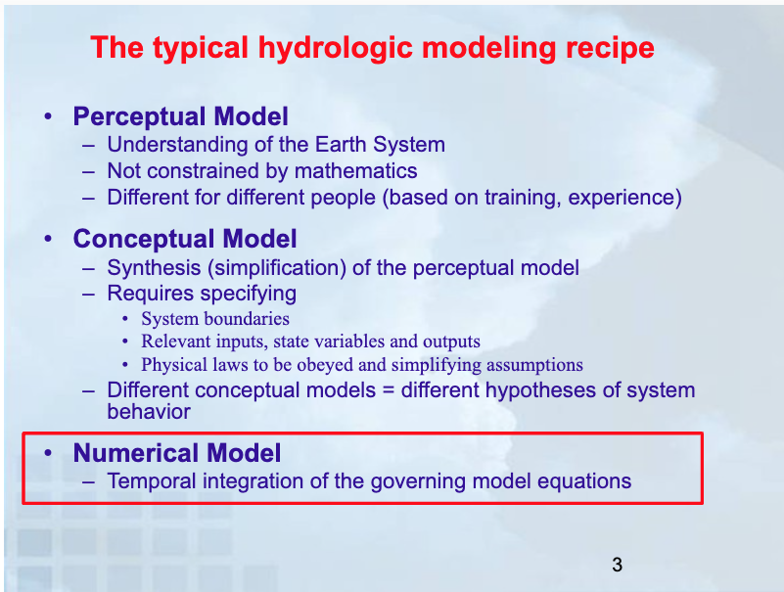

Slide 8
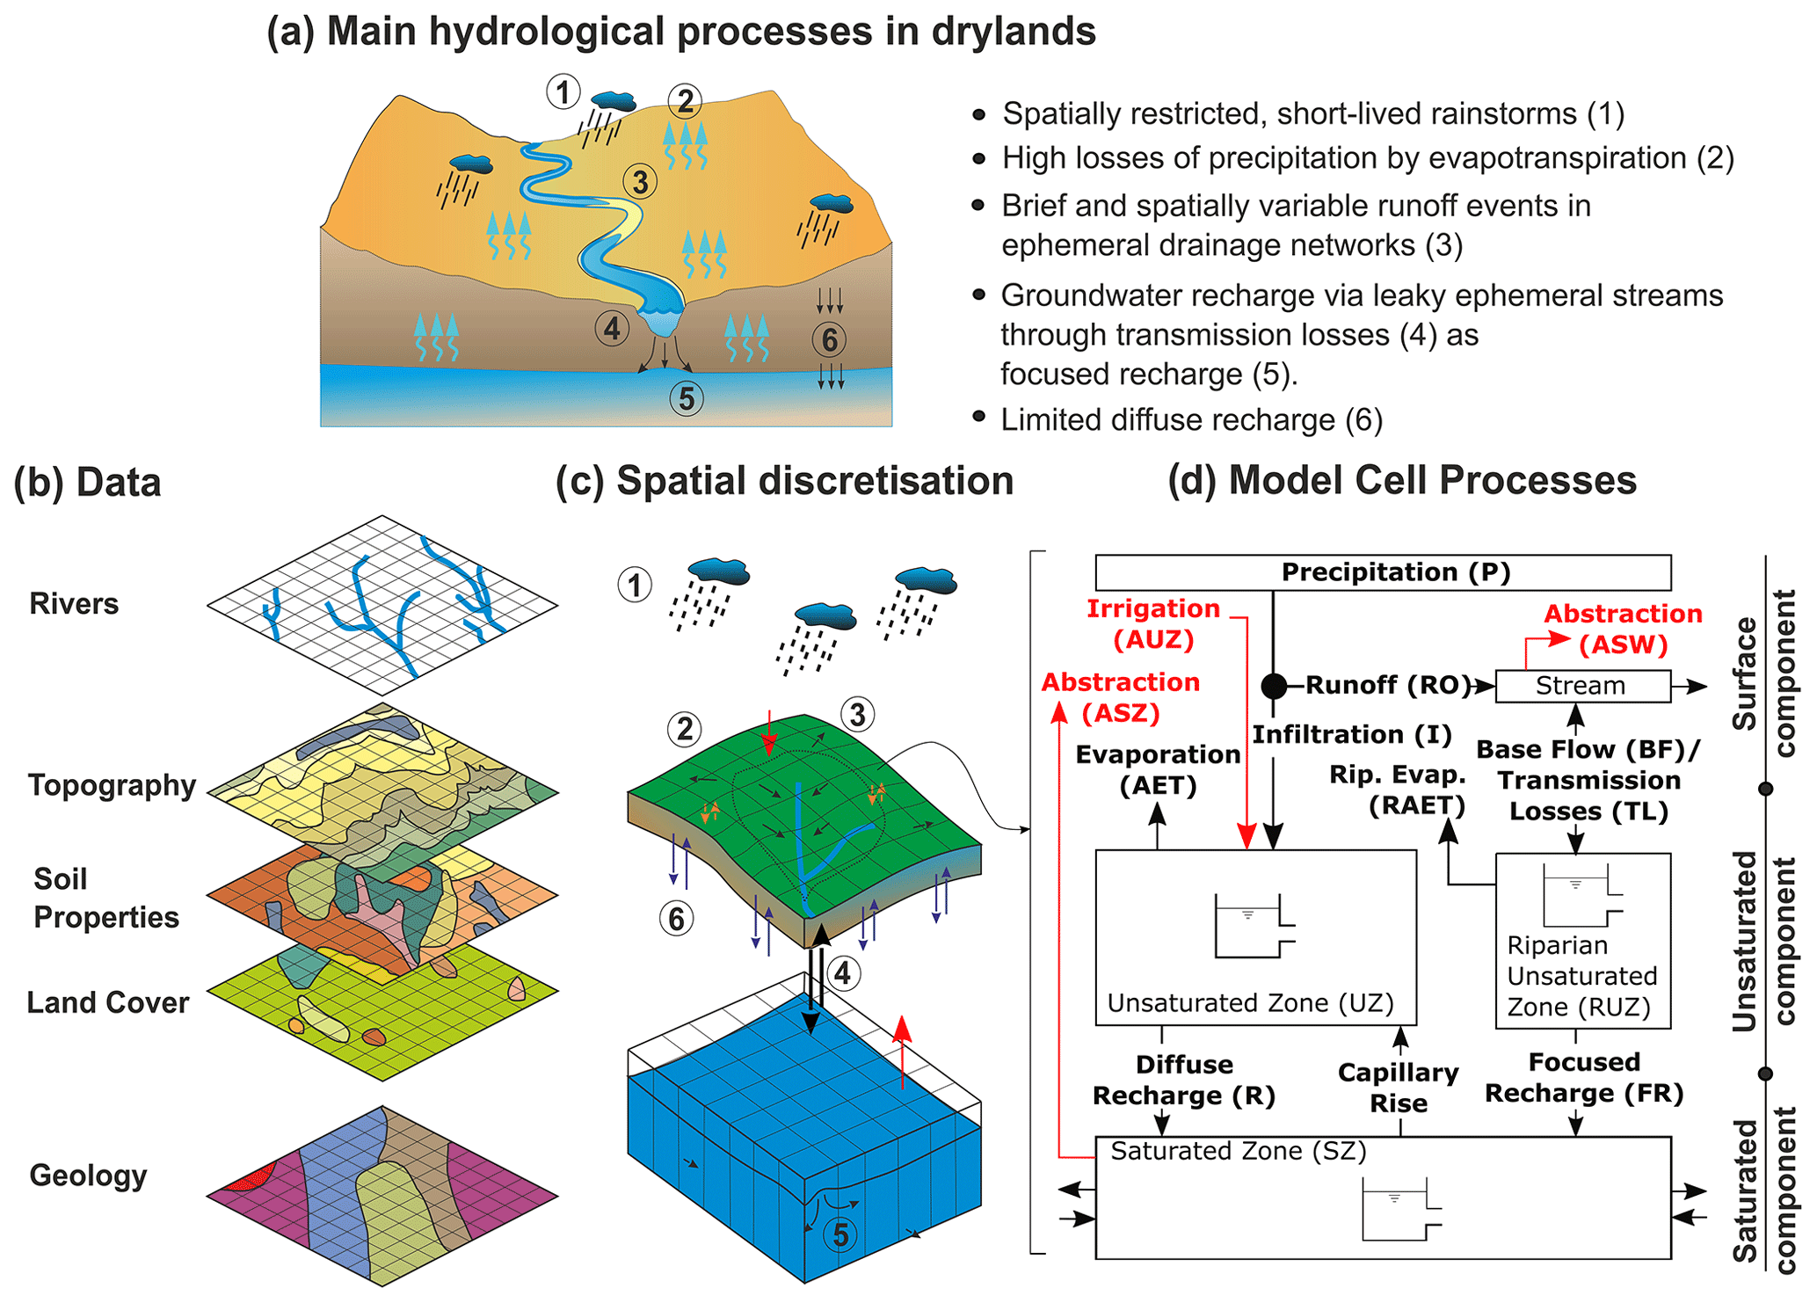

Slide 9
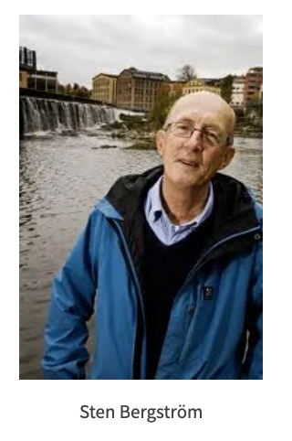
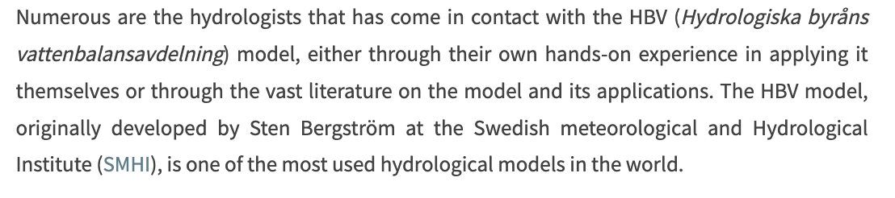
HBV (Hydrologiska Byrans Vattenavdelning) Model

Slide 10
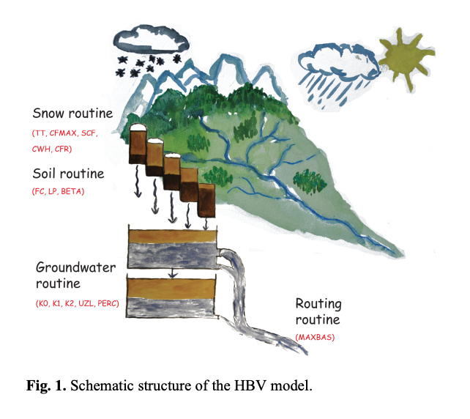
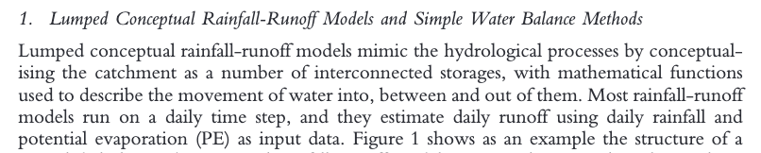
HBV Model
Lumped or semi-distributed conceptual model

Slide 11
HBV Model
Lumped or semi-distributed conceptual model

Slide 12
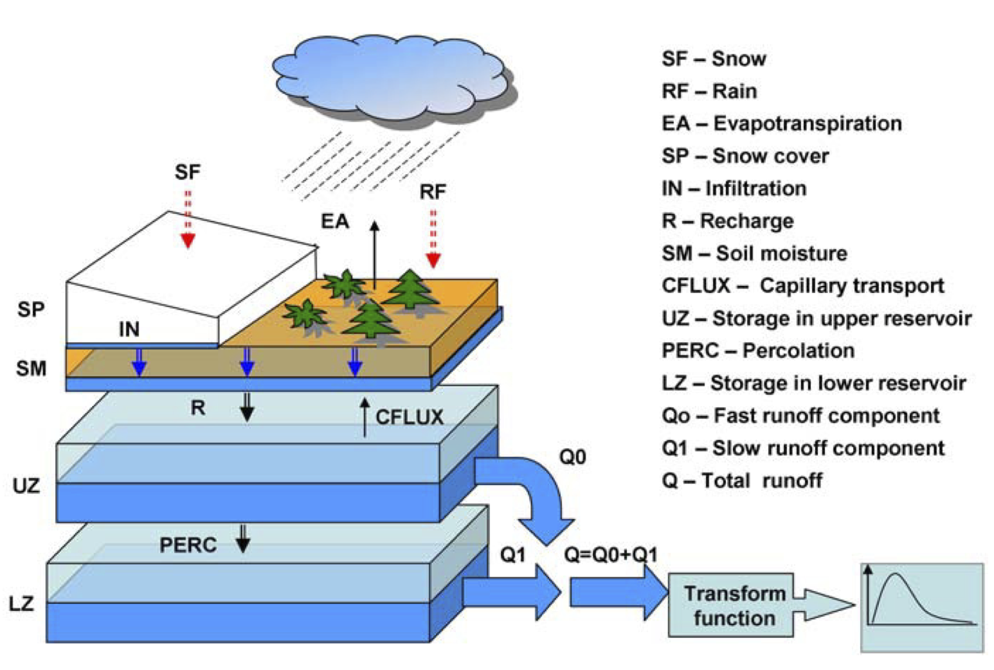
Structure of the HBV Model

Slide 13
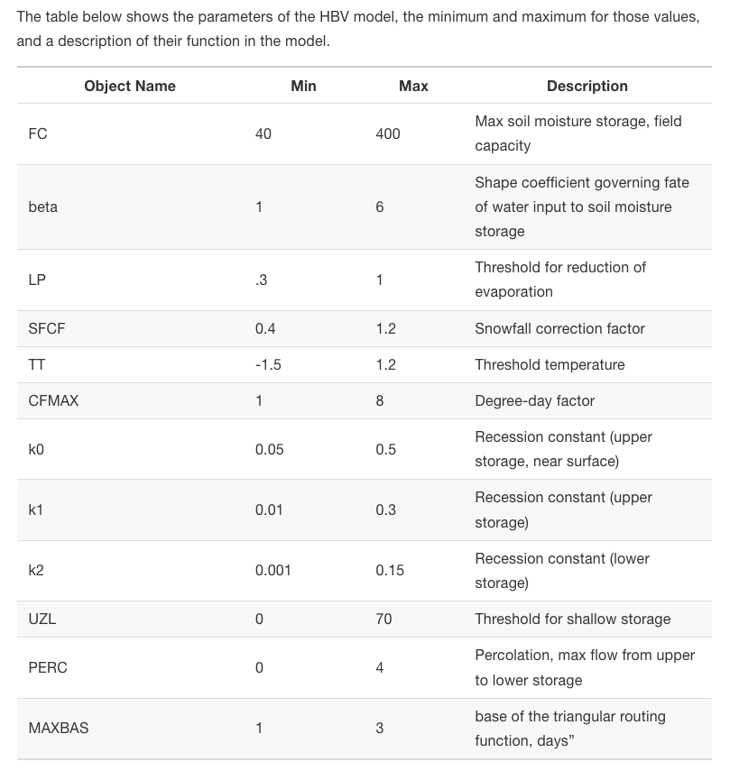

Slide 14
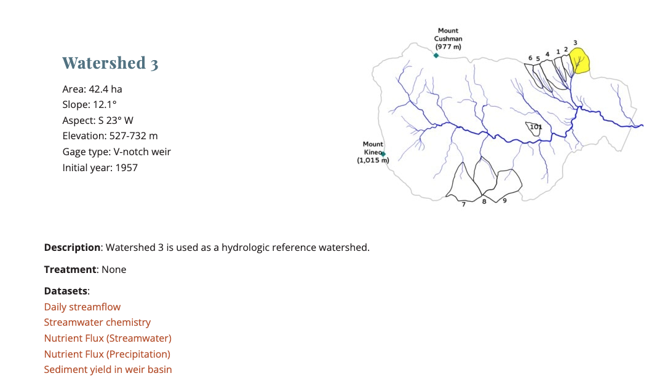

Slide 15
Steps for HBV model
Read in P and T
Calculate PET
Set HBV parameters
Run model
Compare modeled and observed Q
Assess model fit with NSE
Calibrate
Use your process understanding to manually calibrate

Slide 16
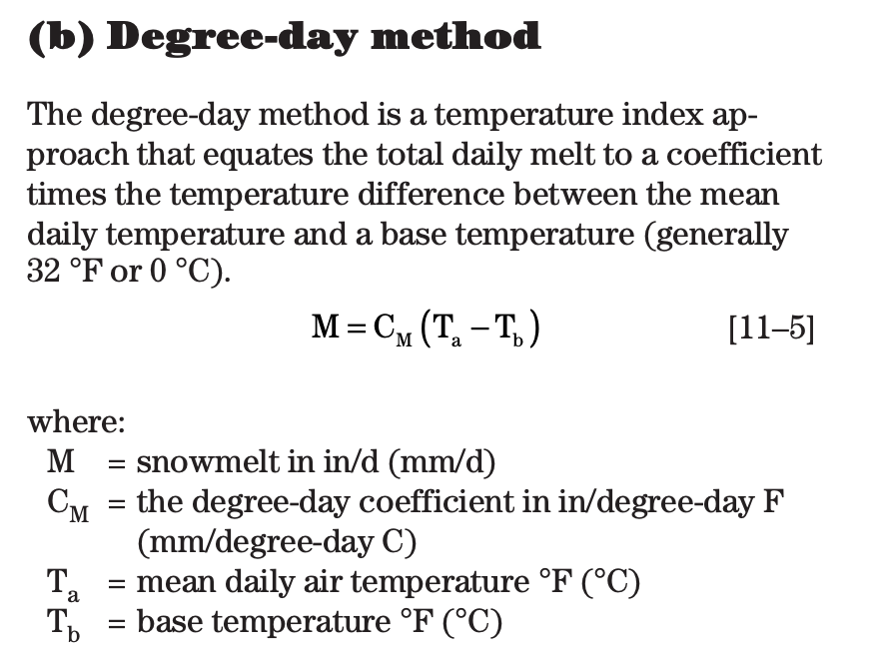
Hamon method, degree days, NSE
The Hamon method (Hamon, 1963) is based on an empirical relationship where saturated water vapor concentration, at the mean air temperature, adjusted by a day length factor, is proportional to PET

Slide 17
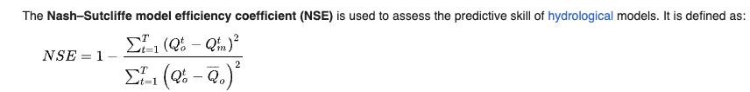
Nash-Sutcliffe Efficiency

Slide 18
Steps for HBV model
Read in P and T
Calculate PET
Set HBV parameters
Run model
Compare modeled and observed Q
Assess model fit with NSE
Calibrate
Use your process understanding to manually calibrate

